Slide 1
KP ACCURACY APP
App user Instruction_v1

Slide 2
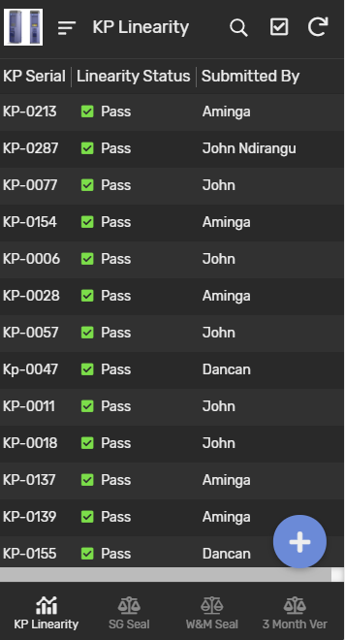
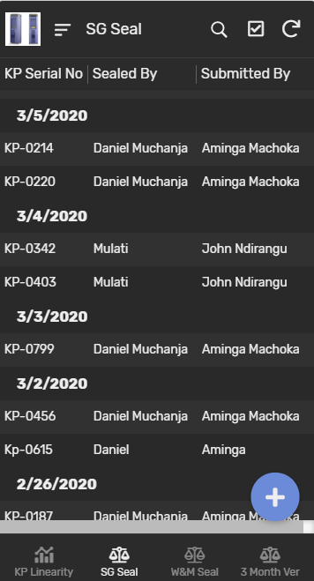
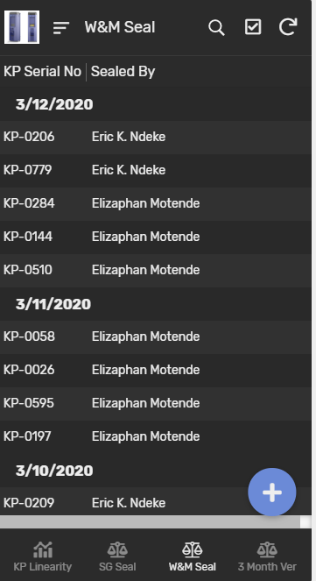
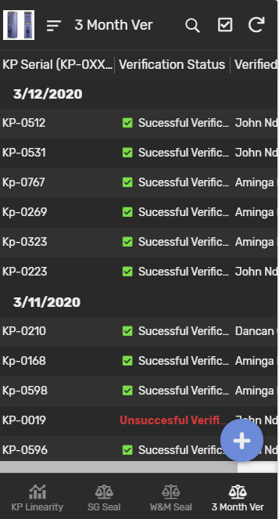
UI Overview
KP Linearity
SG Seal
W&M Seal
3 Month Verification

Slide 3
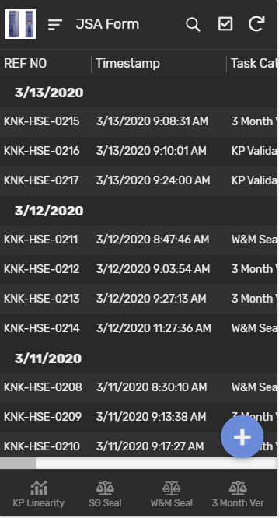
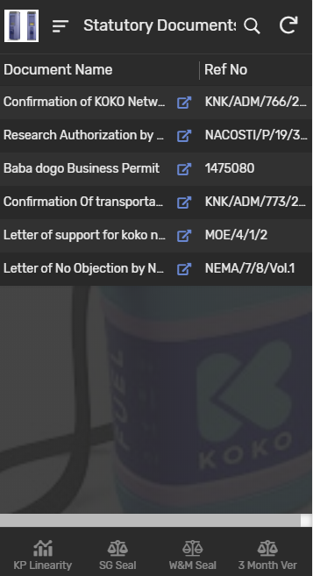
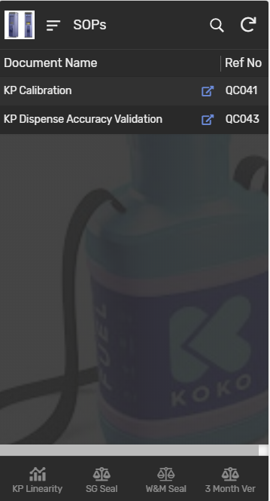
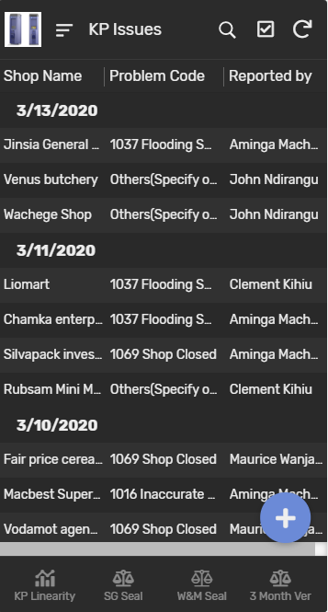
UI Overview
JSA Form
Statutory Documents
Calibration SOPs
KP Issues

Slide 4
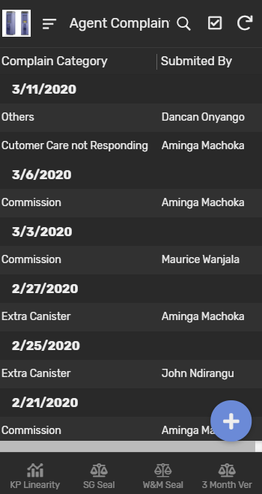
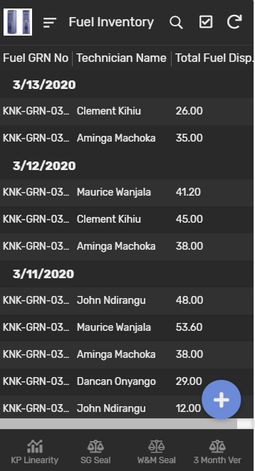
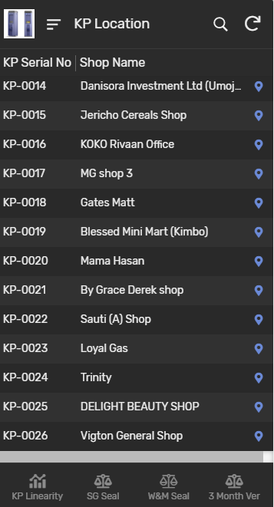
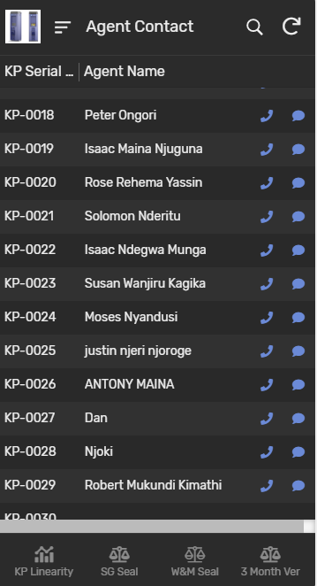
UI Overview
Agent Complaints
Fuel Inventory
KP Location
Agents Contacts

Slide 5

KP Calibration Linearity
Calibration Linearity
Click this button to enter pulses of specific volumes for automatic calculation of the Linearity of the KP.
For the Calibration to be successful the difference in offset at 1000ml and 2000ml should be ±10ml which automatically return result to Pass on the app
Backend database

Slide 6
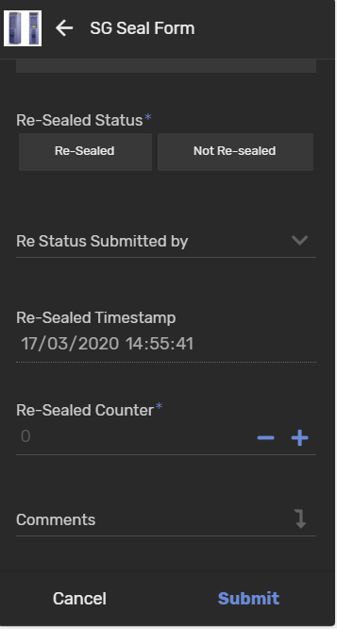
SG Seal
SG Seal
Click this menu button to enter details of the verified and sealed KPs by system group Limited type 6 technicians.
Resealing by SG
Search and edit the details of the resealed KOKOpoint and enter resealed counter number.
Backend database

Slide 7
W&M Seal
W&M Seal
Click this button to enter data of the verified and sealed KPs by W&M inspectors as guided.
If not sealed choose the reason not sealed as guided on the drop down.
Backend database

Slide 8
After 3 Month Verification
After 3 Month verification
Click this button to update the details of the 3 month verification by system group type 6 technicians.
Note that if the KP is unsuccessful Verified,it should be recalibrated and resealed by system group type 6 technician immediately and resealing detail updated on SG seal tab.
Backend database

Slide 9
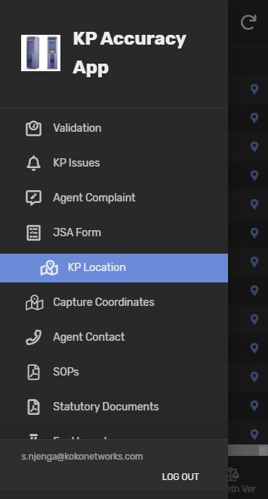
KP Location
KP Location
This is a view only list with all location and direction with commissioned KOKOpoints at the field.
Backend database

Slide 10
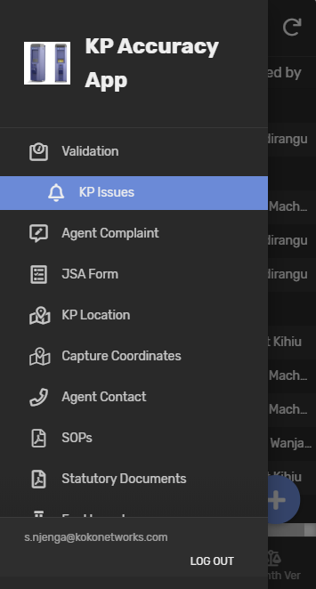
KP Issues
KP Issues
Click this button to describe and enter a details of the KOKOpoints that are out of the service or faulty.
Note that when the KOKOpoint issues is raised and submitted with issue status as Not Resolved it automatically create ticket with NOC freshservice ticketing platform. When issue status is marked as Resolved it does not raise ticket with the NOC Freshservice Platform.
Backend database

Slide 11
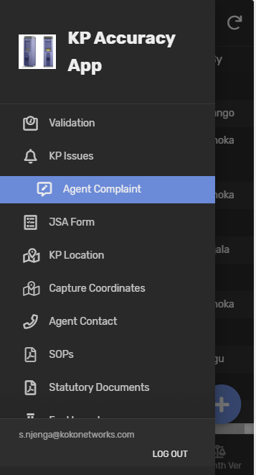
Agents Complaints
Agents and Customer Complaint
To make our agents and customers happy by resolving the issues they encounter on KOKOpoint and cookers, click this button to fully describe the complaint, suggestion raised by customers or agents as guided.
Note that a copy of the agent and customer complaint details is shared automatically via email to concerned internal stakeholders.
Backend database

Slide 12
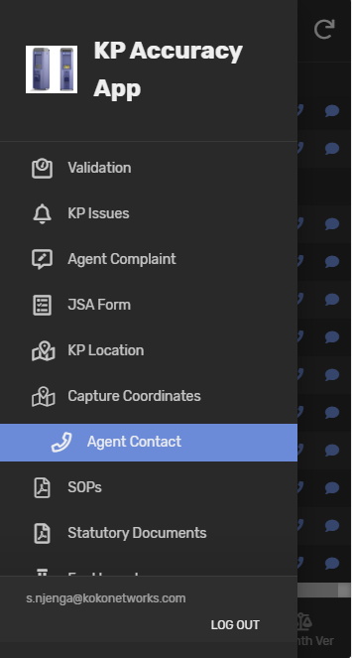
Agents Contacts
Agents Contacts
This is a view only tab with agent phone contacts.search the phone number of the agent and communicate with him/her in case of absence/closed shop during verification/calibration process visit.
Note that on each contacts have details of opening and closing hours of the agent shop.
Backend database

Slide 13
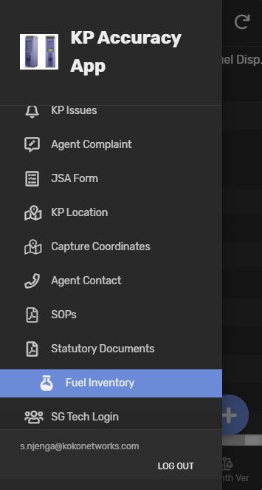
Fuel Inventory
Fuel Inventory
Click this button to enter the daily amount of fuel dispensed/received from field during verification,calibration and validation process.
Note that as per fuel transit document no technician should carry more than 50 litres of fuel on calibration/verification/validation containment.
Backend database

Slide 14
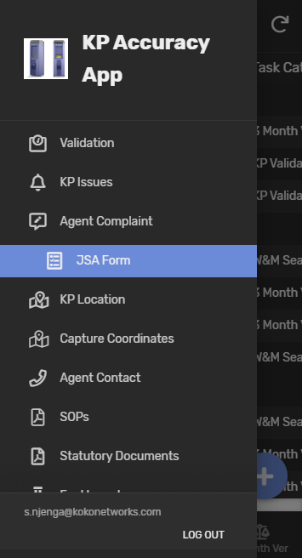
JSA Form
Job safety analysis form
Before commencing any assigned field task/operations click this button to enter and describe details of the assigned task.
No task should be commenced before filling this online form, there shall be weekly audit of JSA form reviewed by HSE coordinators.
Backend database

Slide 15
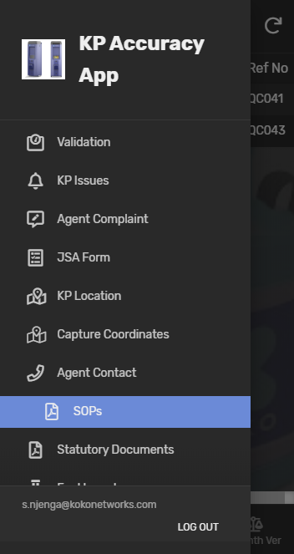
SOPs
Work instructions
Click this menu button to find read only KOKOpoint Calibration work instruction and KOKOpoint Validation Work instruction.
Backend database

Slide 16
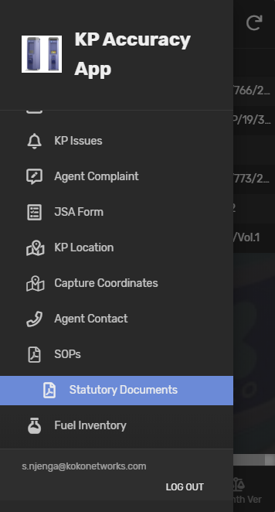
Statutory Documents
Field Statutory Documents
Shows a view only or read only of all statutory documents needed during calibration operation.
Note that the document should be produced to authority when requested.
Backend database

Slide 17
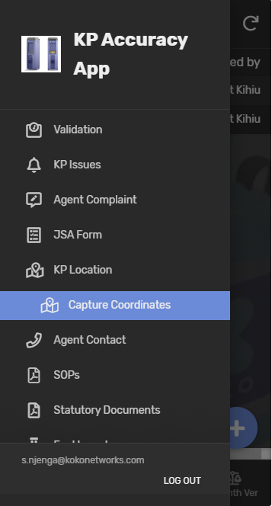
Capture Coordinates
Capture Correct Coordinates
Use this menu button to capture the correct coordinates location of the KOKOpoint.
Note that for this feature to work accurately make sure you have turned on the location of your device.
Backend database

Slide 18
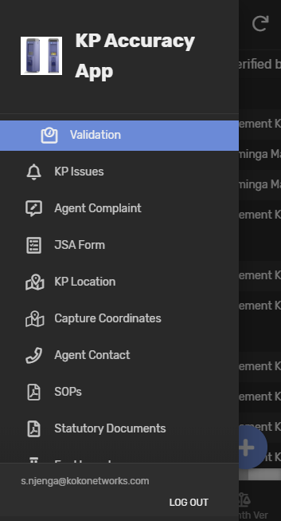
KP Validation
KP Validation
Click this menu button to enter details of KOKOpoint Validation accuracy as required.
Backend database

Slide 19

Thank you

